Slide 1
Mobile game (Clash Royale) match result prediction using multiple machine learning algorithms
Zheng Li
Yiming Wang
Fangwen Wu
A CS 446 semester project

Slide 2
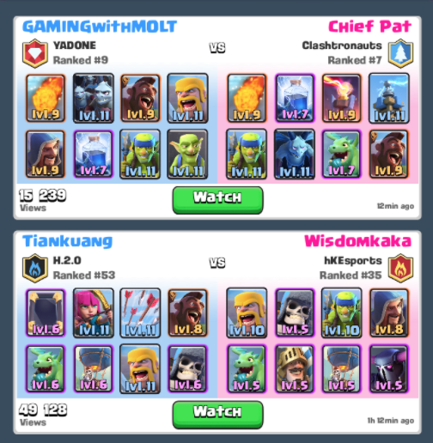
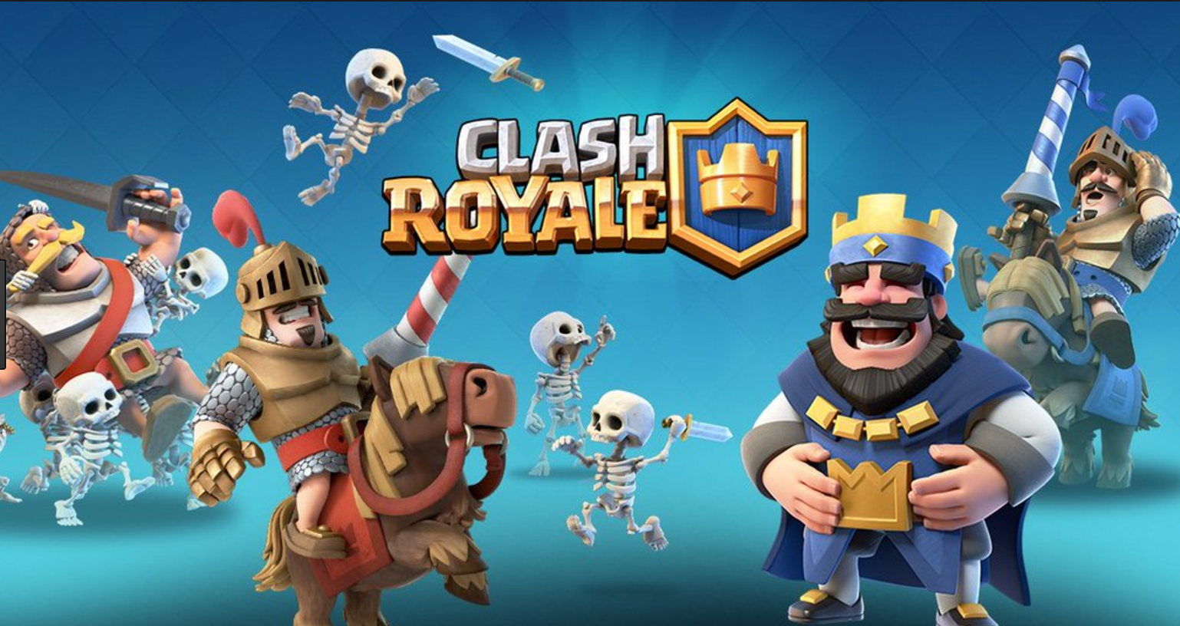
Introduction & Motivation
Clash Royale
Card-based strategic game
Dual players
8 out of 74 cards
Card combination/play style

Slide 3
Introduction & Motivation
Clash Royale
Card-based strategy game
Dual players
8 out of 74 cards
Card combination
Can we predict the match result given two selected battle decks ?

Slide 4
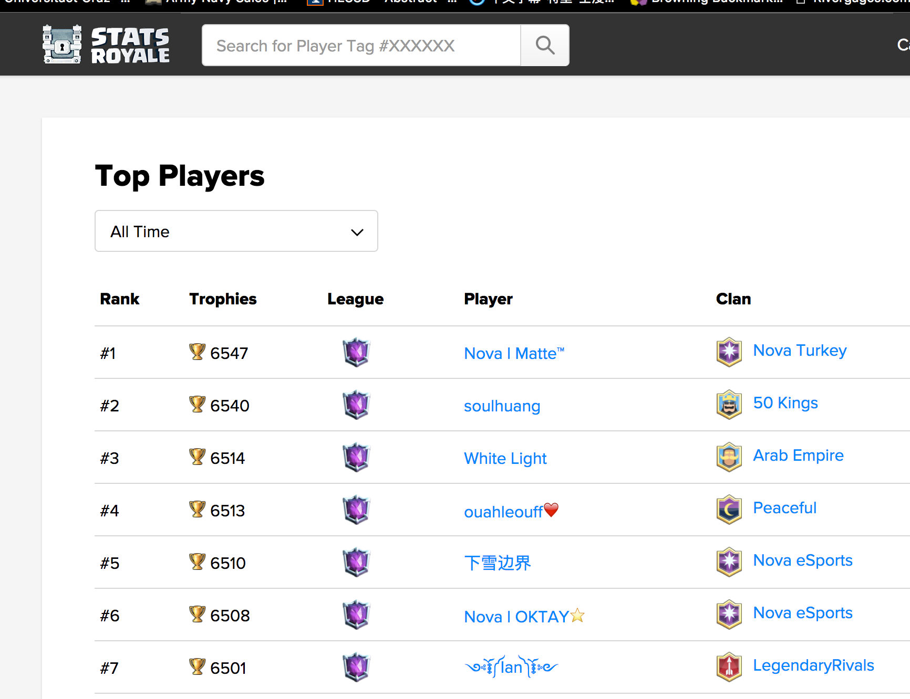
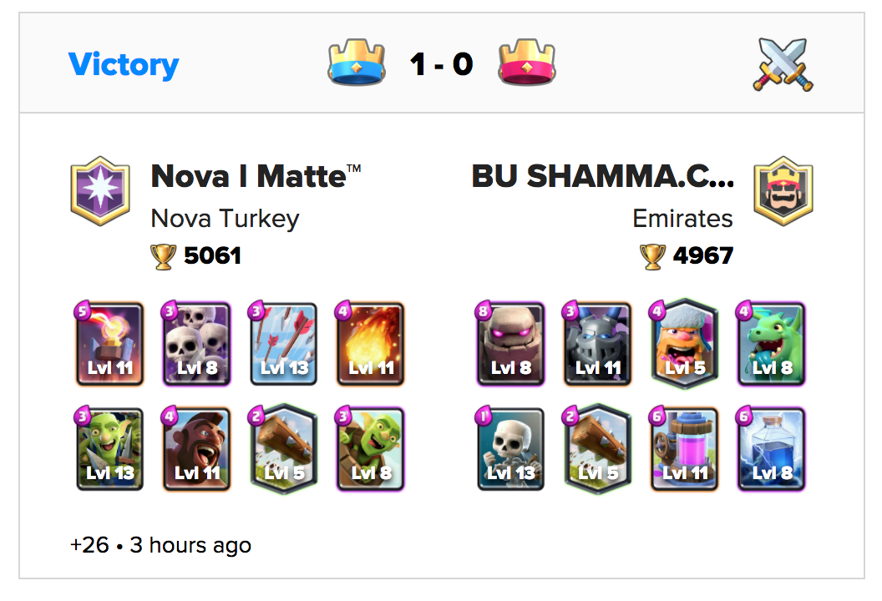
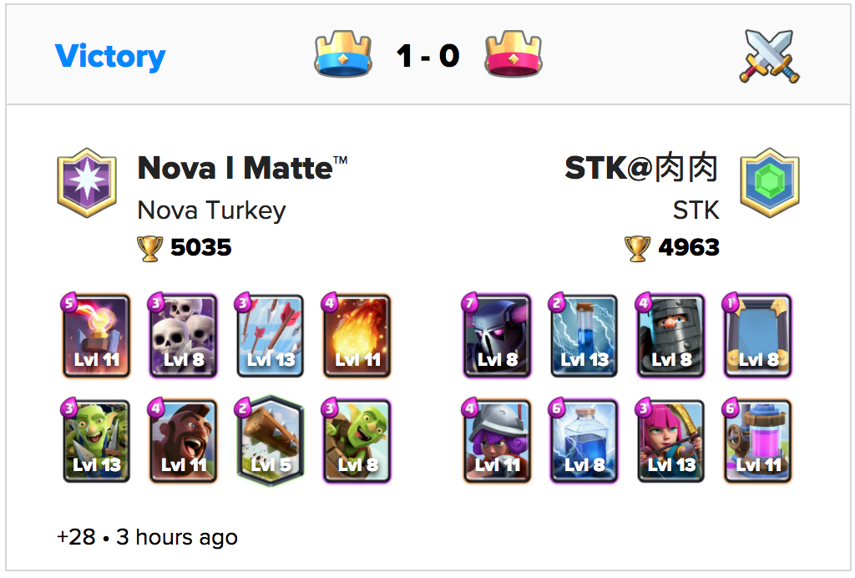
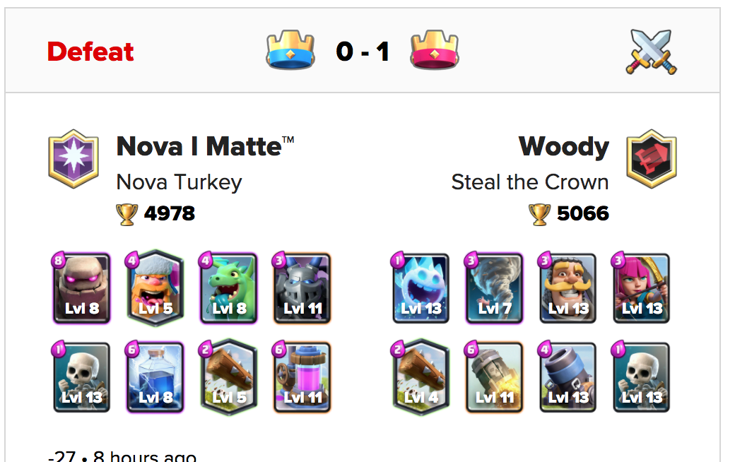
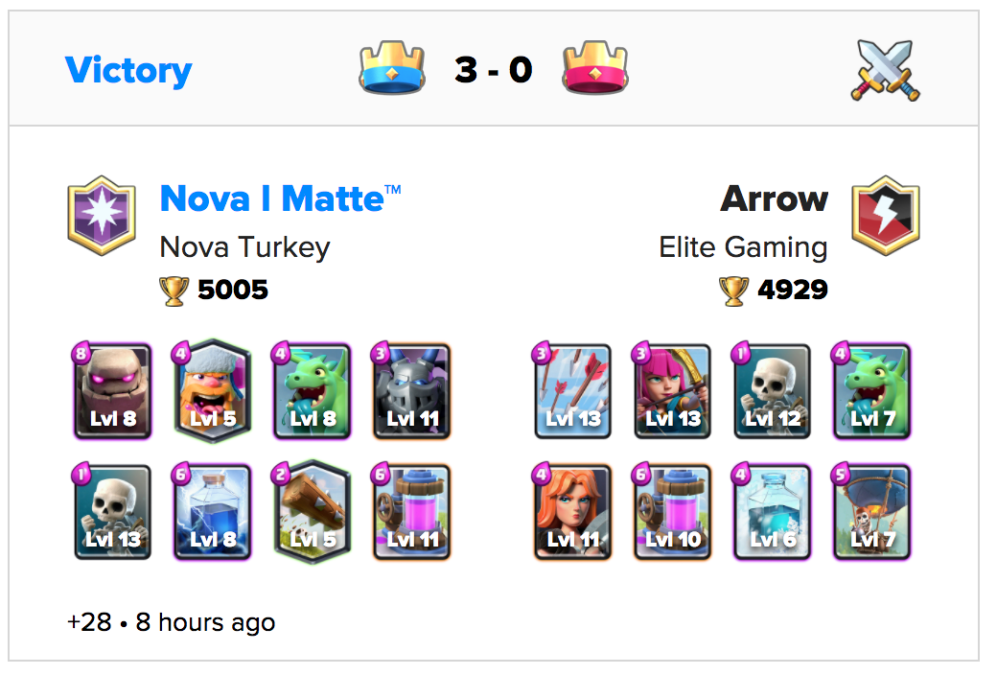
Data Source
Data from StatsRoyale^{[1]}:
Match records from top 1000 players,real-time
Exclude human factors (play style/ skills)
Purely depends on card property/ synergy with each other
[1]: https://statsroyale.com/

Slide 5
Data Source
Data from StatsRoyale^{[1]}:
Match records from top 1000 players,real-time
Exclude human factors (play style/ skills)
Purely depends on card property/ synergy with each other
180,000+ match records
[1]: https://statsroyale.com/

Slide 6
Feature Extraction
{Win,Loss} = {1,0}
Label Space
Deck 1
[1,0,0,1,0,1….0]
Use/Not use
certain card {1,0}
Deck 2
[0,1,1,1,0,0….1]
Deck 1
[1,0,0,1,0,1….0]
{Card Type, Rarity, Cost}
Deck 2
[0,1,1,1,0,0….1]

Slide 7
Proposed Alogrithm
SVM
Decision Tree
Naïve Bayes
Neural Network
Adaboost
Randon forests
AdaBoost over Decision tree

Slide 8
Results

Slide 9
Discussion & Future Work
Extend to multi-class classification
Better feature extraction
More application extension

